Slide 1
AutoDocs
Andrew Ross
Mantas Drungys
Srikanth Ramesh
Nanjunda Reddy
MurliKrishna
Manish Bagwari

Slide 2
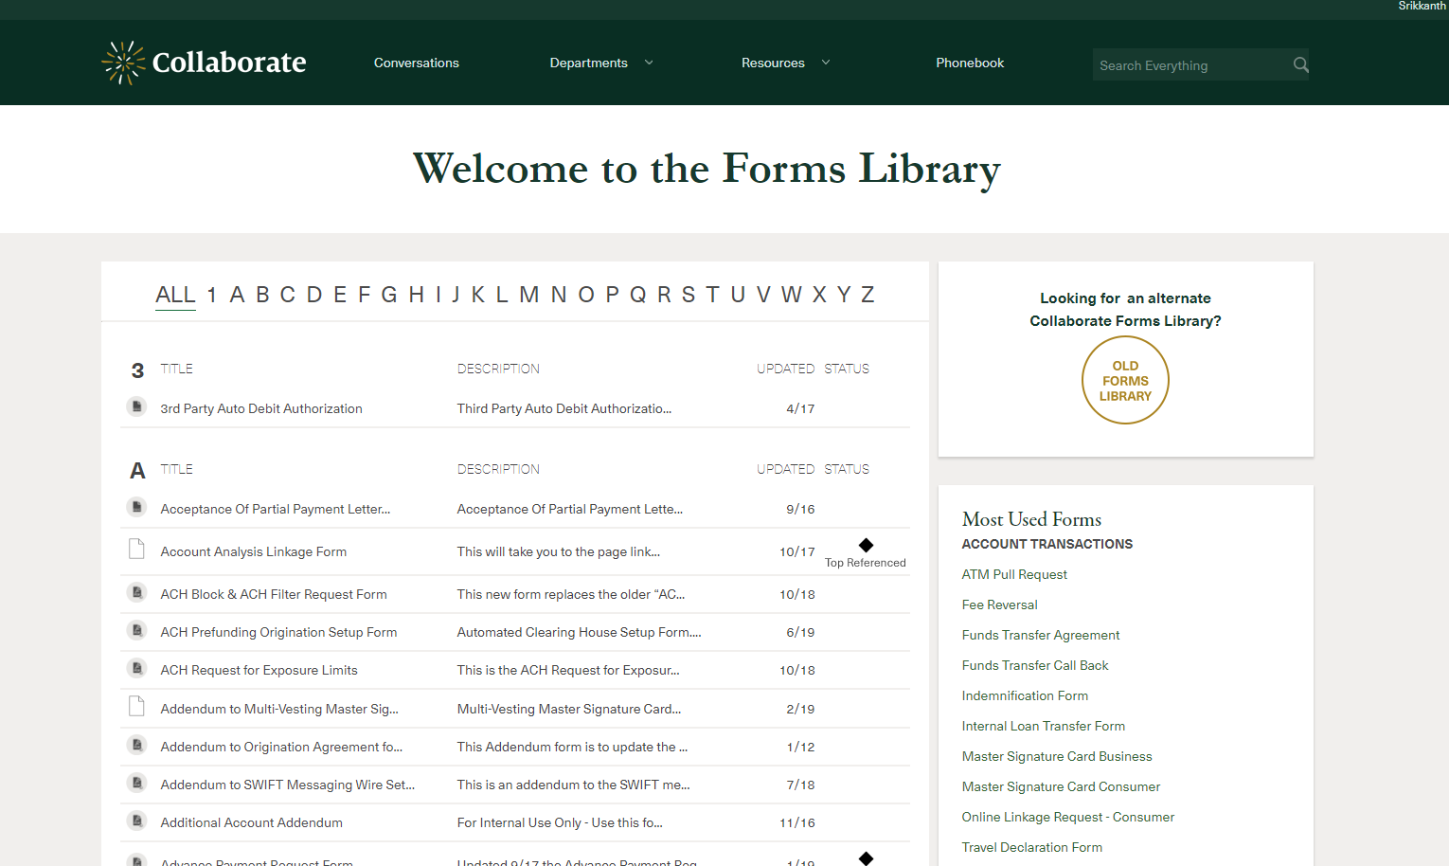
Problem Statement
15+ Departments using Collaborate Forms
Over 500 Forms require manual entry

Slide 3
How do we approach the Solution
Automate the process of collecting data by using existing databases
Dynamically pre-fill the information in pre-selected templates
Show fields that need attention
Abilities to save, share and print the populated documents
Categorize Documents & Provision Access if document is restricted

Slide 4
What this means to the business
Average time savings per document – ~ 5 to 30 minutes
Number of daily document populations – 1000
Total time saved / day – 80+ hours
Time saved in a month – 1600+ hours
Annual Savings - $1,000,000+

Slide 5
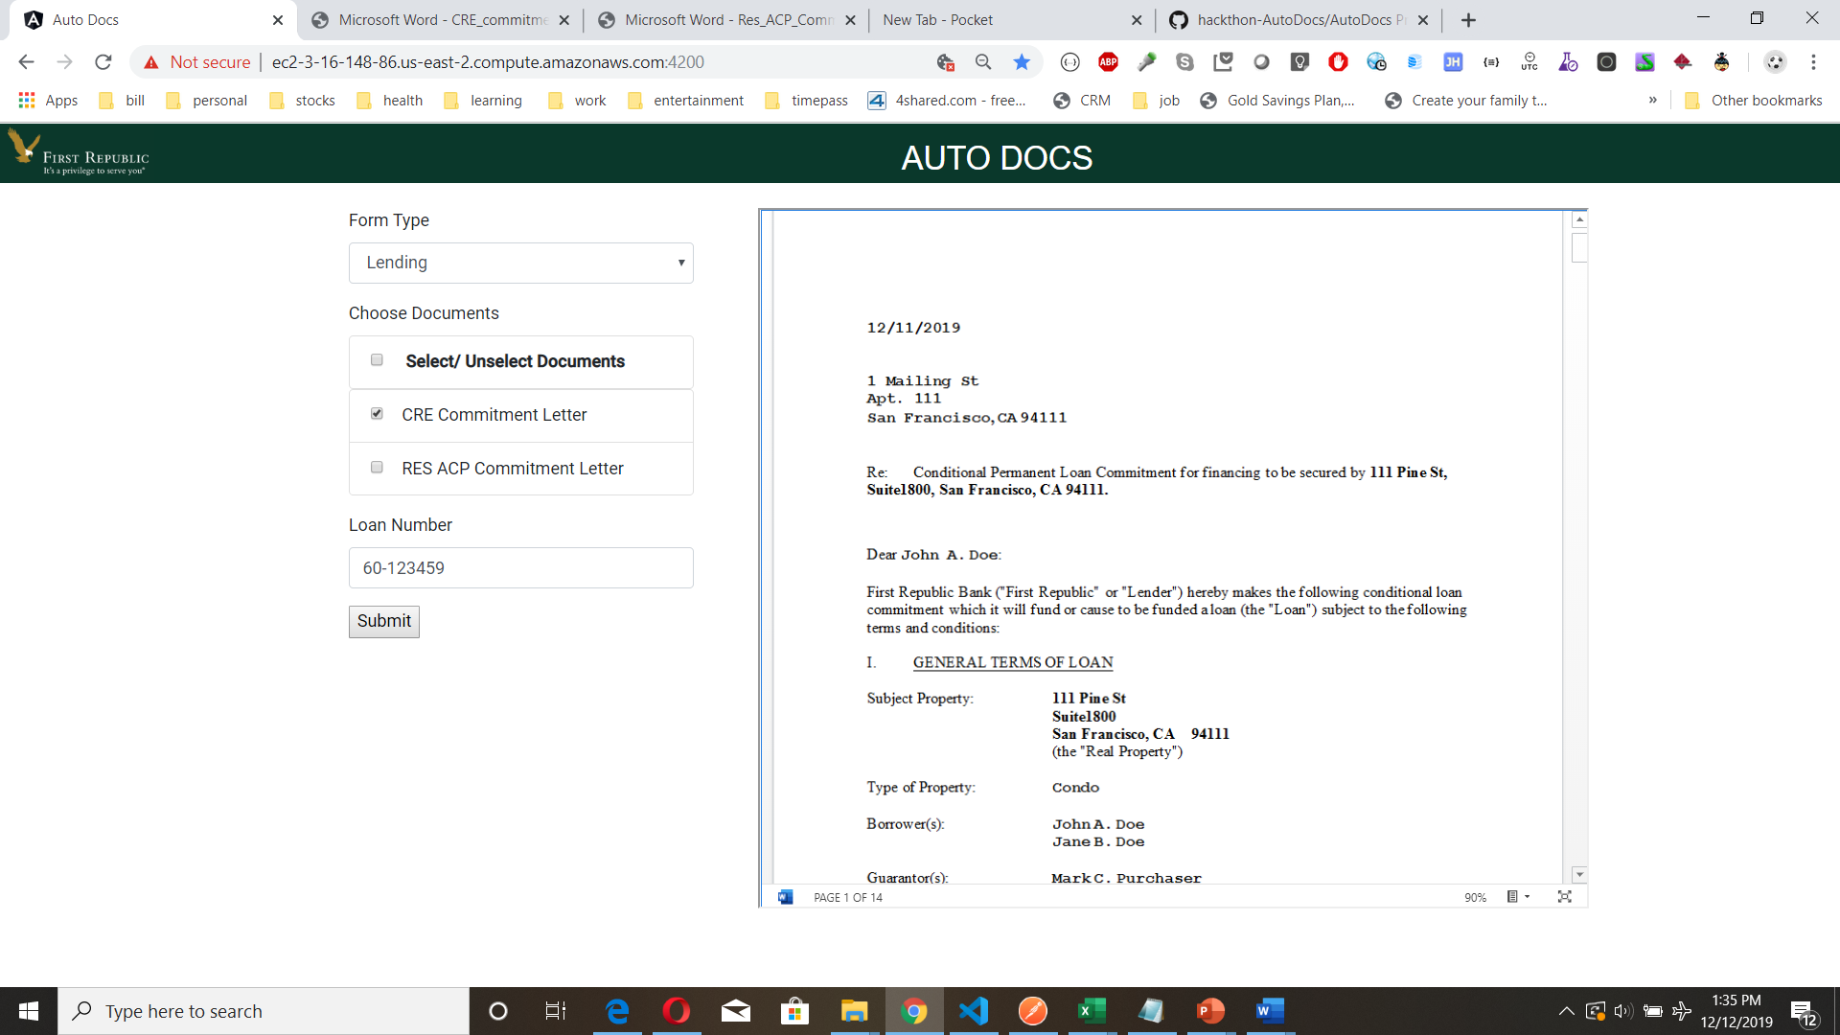
AutoDocs Demo

Slide 6

What are the Key AutoDocs Benefits
Automate document upload to ON-BASE
Scale across large volume of data quickly and efficiently
Improve data quality and accuracy
Alleviate manual effort to search data across multiple interfaces
Alleviate human errors from typos
Securely share documents amongst authorized individuals

Slide 7

Solution and enhancement
Auto Docs
Processor
(UI + Processing)
1 – Select Form Type
2 – Select key-value data to be searched viz. SSN, Loan # etc.
FRB Business Users
Store finished documents
FRB INSTABASE
Collaborate
(Template Documents)
Template documents
AWS S3
(Documents
storage)
AI/ML enhancements (OCR capabilities)
Aggregated Data
Store finished documents
ON BASE
(Transformed Documents)
FRB
Data Source 1
Populate Data
FRB
Data Source 2
FRB
Data Source 3
Demo components
Envisioned for target state

